Slide 1








2018
2017
The PowerShell Formatting System
Shaping Your Objects
Build an immutable application infrastructure with Nano Server, PowerShell DSC, and the
release pipeline
Ravikanth Chaganti
Staffan Gustafsson

Slide 2
Agenda
What is the formatting system?
Simple formatting
List
Table
Custom
Advanced Formatting
Collection
Grouping
Colors
The brightness of the Future

Slide 3

Agenda

Slide 4
The Formatting Subsystem
Projects objects to text
Based on types
FormatData is stored on a per-type basis
Out-Default
Is appended by PowerShell if output is not redirected
Format as table if ≤ 5 properties
Format as list otherwise
Wait 300 ms when formatting table to determine width
Notes:
Projects objects to text
Key strength of PS that is handles to projection from objects to text
This gives us all the benefit of working with objects, and still have a very flexible way of getting human readable output
Based on types
FormatData is stored on a per-type basis
End users writes formatting data in a horrible xml dialect

Slide 5
The Formatting Subsystem
DefaultDisplayPropertySet
Properties in lists and tables
DefaultDisplayProperty
Format-Wide, Objects in collections
$FormatEnumerationLimit
How many objects to render in a collection
Properties Name, ID, Key* gets special treatment
Used as display properties if not explicitly specified
Unless the type implements ToString()
// we failed the default display name, let’s
// try some well known names
// trying to get something potentially useful
string[] knownPatterns = new string[] {
"name", "id", "key", "*key", "*name", "*id",
};

Slide 6
Super Heroes setting the stage
Default formatting
Display properties in type system

Slide 7
The Formatting Subsystem
How is a formatter selected?
Either by Type
or by Types
<ViewSelectedBy>
<TypeName>SuperHeroTypes</TypeName>
</ViewSelectedBy>
<SelectionSet>
<Name>SuperHeroTypes</Name>
<Types>
<TypeName>SuperHero</TypeName>
<TypeName>SuperVillain</TypeName>
</Types>
</SelectionSet>
</SelectionSets> … <ViewSelectedBy>
<SelectionSet>SuperHeroTypes</SelectionSet>
</ViewSelectedBy>

Slide 8
Simple formatting - Lists
Simplest formatter to write
<ListItem>
<PropertyName>Id</PropertyName>
</ListItem>
<ListItem>
<PropertyName>Power</PropertyName>
<ItemSelectionCondition>
<ScriptBlock>$null –ne $_.Power</ScriptBlock>
</ItemSelectionCondition>
</ListItem>
<ListItem>
<Label>Weight (lb)</Label>
<FormatString>{0:0}</FormatString>
<ScriptBlock>$_.Weight/0.454</ScriptBlock>
</ListItem>

Slide 9
Format-List

Slide 10
Simple formatting - Table
More dense
Easier to get an overview of the data
-Wrap, -AutoSize

Slide 11
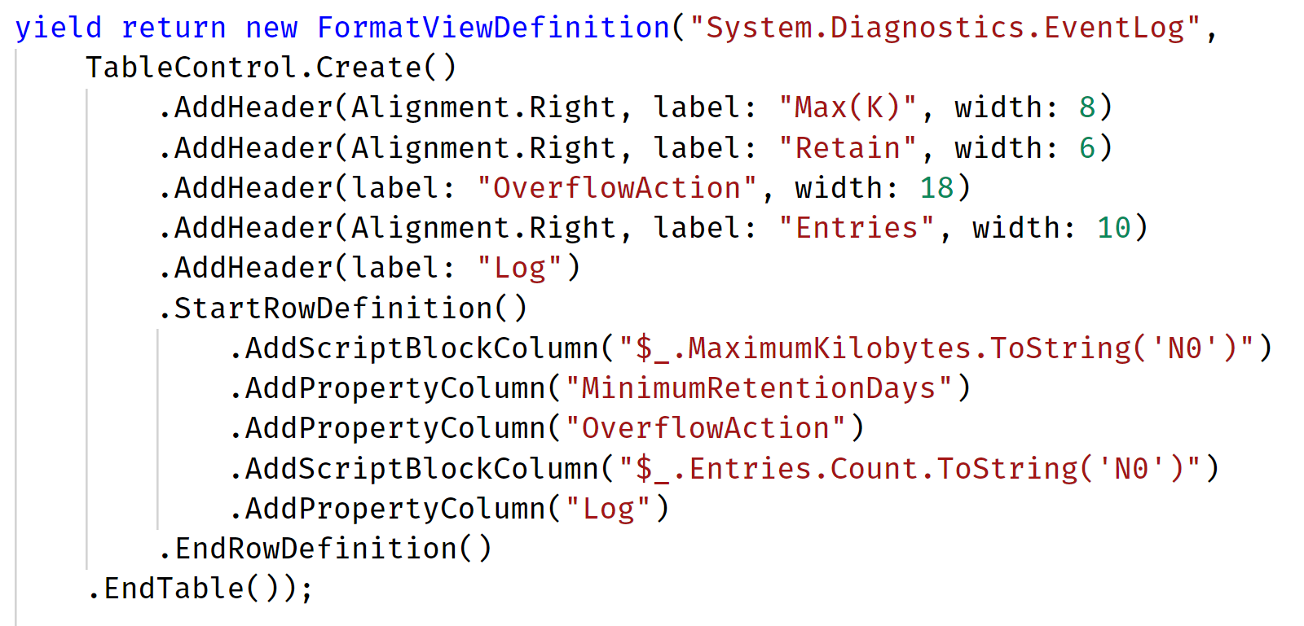

Simple formatting - Table
TableControl – basic structure
<TableControl>
<AutoSize/>
<HideTableHeaders/>
<TableHeaders>
<TableColumnHeader>
<Width>15</Width>
<Label>Name</Label>
</TableColumnHeader>
<TableColumnHeader>
<Width>20</Width>
<Label>AlterEgo</Label>
<Alignment>Center</Alignment>
</TableColumnHeader>
</TableHeaders>
<TableRowEntries>
<TableRowEntry>
<TableColumnItems>
<TableColumnItem>
<Alignment>Left, Right, or Center</Alignment>
<PropertyName>Name</PropertyName>
</TableColumnItem>
<TableColumnItem>
<PropertyName>AlterEgo</PropertyName>
</TableColumnItem>
</TableColumnItems>
</TableRowEntry>
</TableRowEntries>
</TableControl>
<TableControl autoSize="true" noHeaders="true">
<Header width="15" Label="NameLabel"/>
<Header width="30" Label="ALabel" align="Right"/>
<Column property="Name"/>
<Column format="{0,-20}">$_.AlterEgo</Column>
</TableControl>
<TableControl>
<AutoSize/>
<HideTableHeaders/>
<TableHeaders>
<TableColumnHeader>…</TableColumnHeader> …
</TableHeaders>
<TableRowEntries>
<TableRowEntry>
<TableColumnItems>
<TableColumnItem>…</TableColumnItem> …
</TableColumnItems>
</TableRowEntry>
</TableRowEntries>
</TableControl>
…
<TableColumnHeader>
<Width>15</Width>
<Label>Name</Label>
</TableColumnHeader>
<TableColumnHeader>
<Width>20</Width>
<Label>AlterEgo</Label>
<Alignment>Right</Alignment>
</TableColumnHeader>
…
…
<TableColumnItem>
<PropertyName>Name</PropertyName>
</TableColumnItem>
<TableColumnItem>
<Alignment>Left, Right, or Center</Alignment>
<ScriptBlock>'aka' –f $_.AlterEgo</ScriptBlock>
</TableColumnItem>
…

Slide 12
Format-Table

Slide 13
Debugging Views
When things go wrong
Format-* -DisplayError
Format-* -ShowError

Slide 14
Debugging Views

Slide 15
Advanced formatting – Custom views
Custom Control
EnumerateCollection
CustomControlName
ExpressionBinding
Fancy talk for PropertyName or ScriptBlock
Frame
controls indentation of the item it contains

Slide 16
Advanced formatting – Custom views
CustomControl
Even more verbose
First a demo
Then a look in VS Code

Slide 17
Format-Custom

Slide 18
Advanced formatting – Colors
VT100 escape codes
16 colors
`e[<n>m – where <n> is 30-37, 90-97
256 colors
`e[38;5;<n>m – where <n> is 0-255
Very many colors
`e[38;2;R;G;Bm – where r,g,b is 0-255

Slide 19
Advanced formatting – Colors
`e in PS 6
“`e[91mHi`e[0m”
[char]27 in PS < 6
$e = [char]27 # sometimes seen as [char]0x1b “$e[91mHi$e[0m”

Slide 20
Advanced formatting – Colors
Don’t forget that a large percentage of your users are color blind
Don’t hard code colors. Provide options for the color blind!

Slide 21
Colors

Slide 22
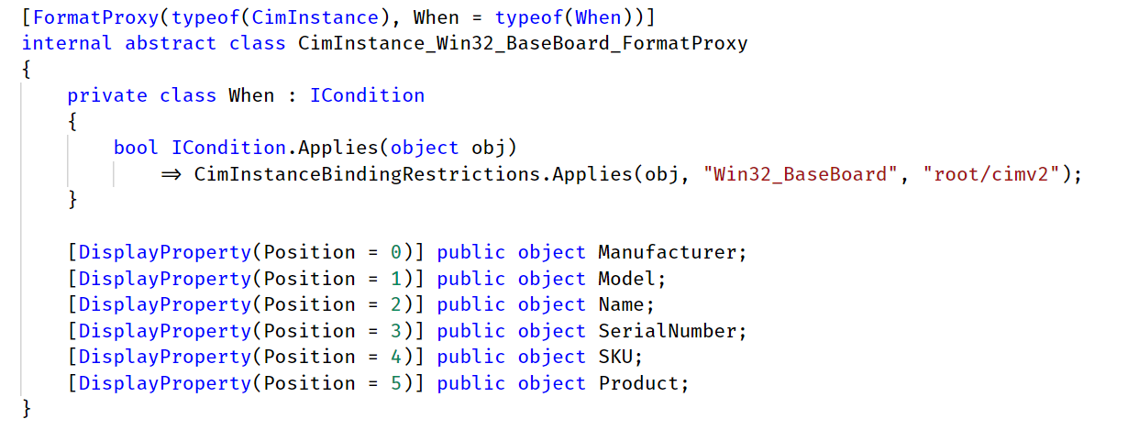
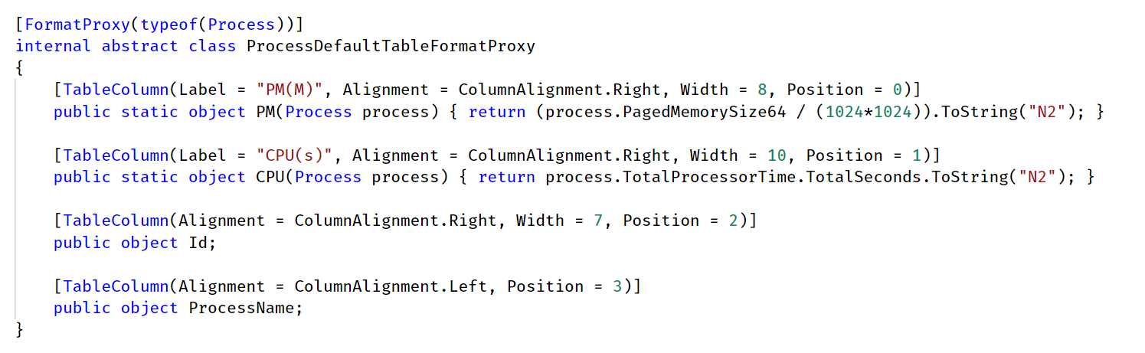
PSMore – a possible future
Gets rid of the XML
Describe formatting in Code
Faster – Using expression trees that gets compiled on first usage

Slide 23
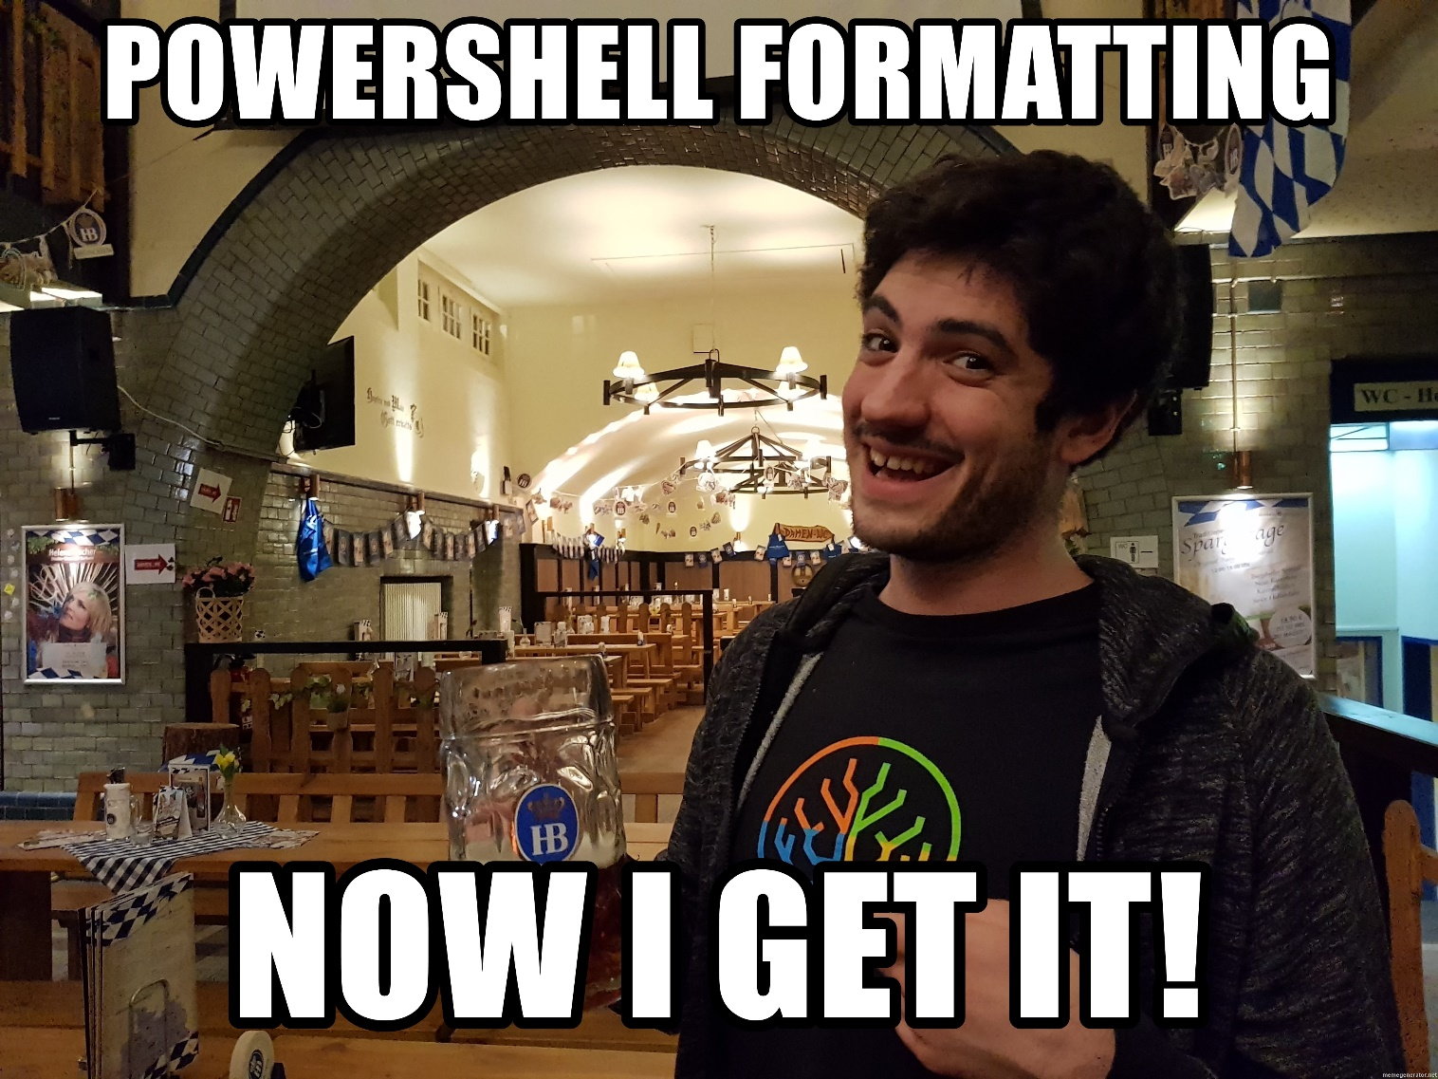
Formatting

Slide 24
Summary
Formatting as super useful to be able to give different views of your data
XML is verbose
Colors makes a difference
and don’t forget the color blind
The future is so bright, I have to …

Slide 25
Next Steps
Now: 15 min break
Grab a coffee
Stay here to enjoy next presentation
Change track and switch to another room
Ask me questions or meet me in a breakout session room afterwards

Slide 26
Questions?

Slide 27
about_Author
Staffan Gustafsson
Daytime: working at DICE, making AAA games such as Battlefield and Star Wars Battlefront
After hours: Fighting crimes against humanity (like poorly formatted code) with a secret identity and a really cool, skintight, outfit
Software Engineer with an interest in languages, debuggers and automation
Github:@powercode
Twitter: StaffanGson

